Slide 1
Chapter 6: Creating a Custom Dialog
Learning Bluemix & Cognitive
Bob Dill, IBM Distinguished Engineer, CTO Global Technical Sales

Slide 2
Chapter 6: Creating a Custom Dialog
Identifying who we are: cookies
Why … restful services, no authentication yet
How would authentication help?
Creating and Using cookies
The flow:
talk to Watson, send text for analysis
Identify most likely classifier and tell user.

Slide 3
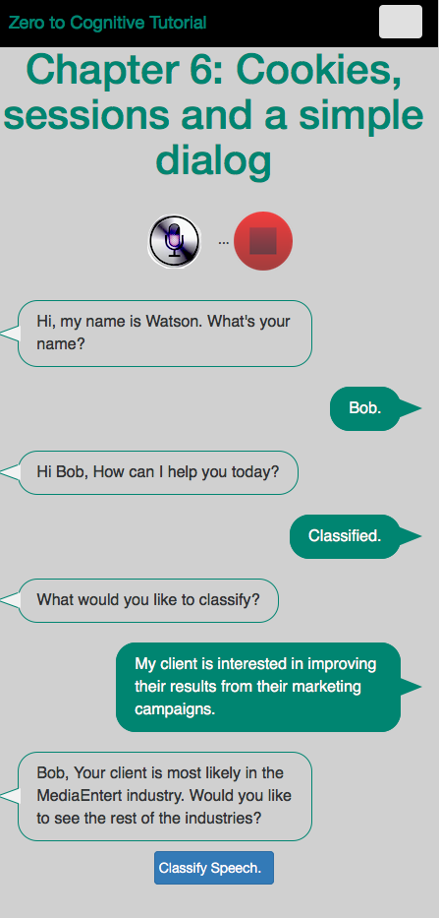
What are we going to build today?
Watson greets you and asks for your name
You respond with your first name/salutation
Store Name in Cookie
Store state in Cookie
Watson responds with “Hi, {name}, …
Name extracted from cookie, passed in text to server
You respond with ‘classify’
Watson responds with “what would you like …
Store state in Cookie
You respond with text to classify
Store state in Cookie
Watson responds with “Bob, your client is …
Store state in Cookie
Store state in Cookie
You answer “Yes” and click stop or Classify
Watson responds with the popup window from lesson 5
Name extracted from cookie, passed in text to server
Pop-up processed locally

Slide 4
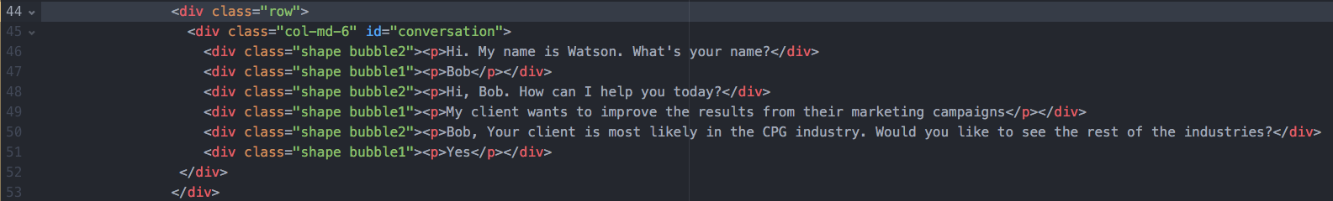
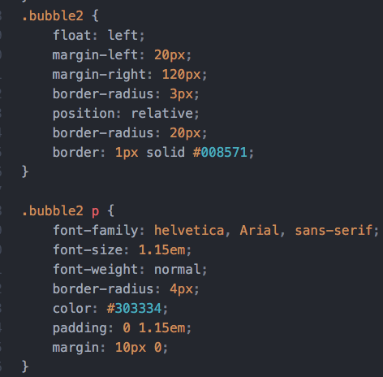
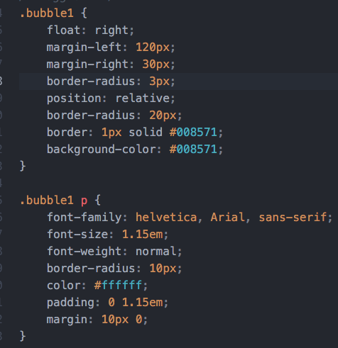
HTML and CSS

Slide 5
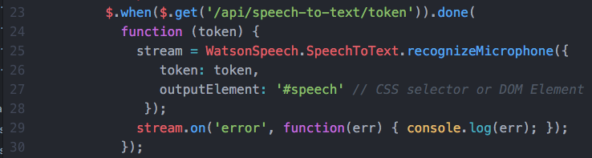
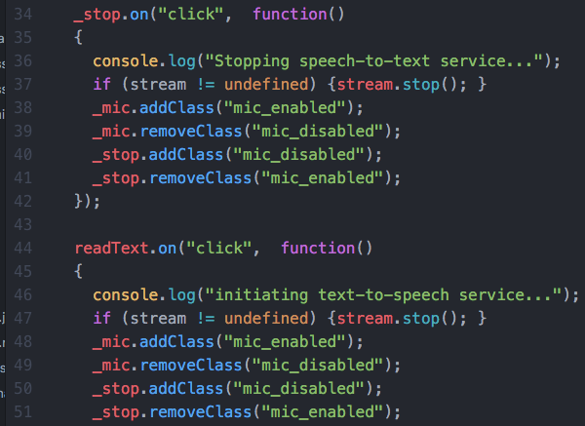
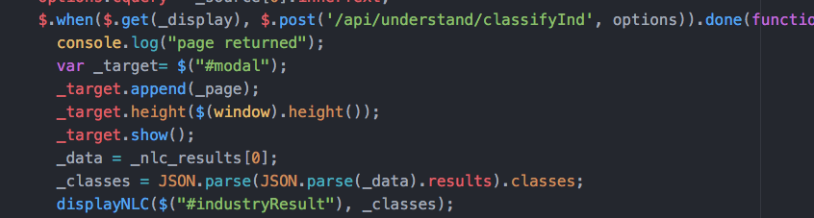
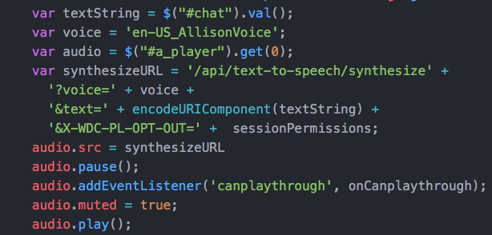
Refactoring
The objective in refactoring any piece of code is to identify those portions which will be duplicated if they are not rewritten. In our case, both the code in the z2c-speech and z2cNLC files will benefit from refactoring.
The code to reset the classes for the microphone and stop button are repeated several times in the code. This creates unnecessary code and creates opportunities to insert bugs in the code.
We want to be able to use the speech to text service and dynamically tell it what html element to link to, so it makes sense to refactor this code.
In the Z2C NLC file, the function which posts the classification request to the server also automatically calls the display function which pops up the modal dialog. This is not what we want to have happen, so we need to do a little refactoring here, too.
We want to be able to use the text to speech service repeatedly and hide the audio control. Again, refactoring here makes sense.

Slide 6
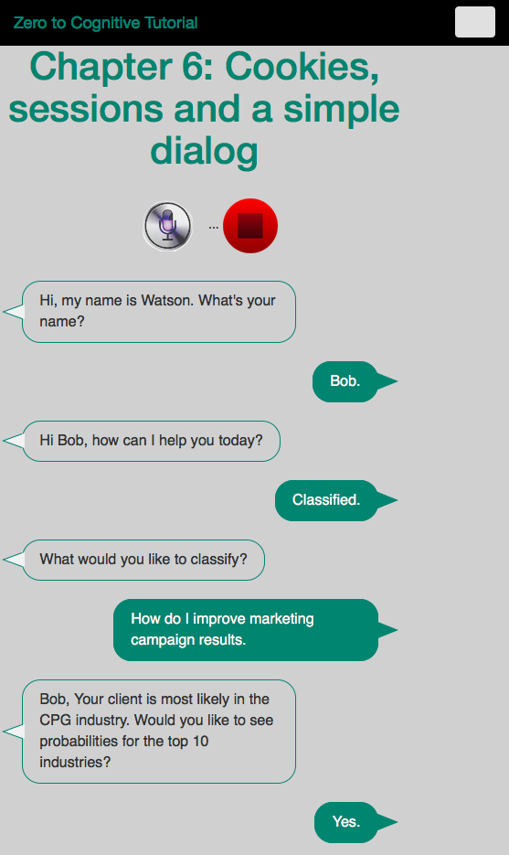
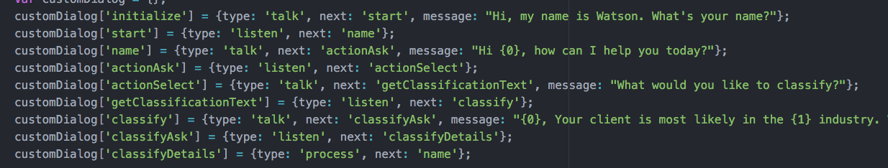
The Custom Dialog
There are nine steps in this custom dialog:
Initialization - greeting if Watson does not know your name.
providing your name
Watson responding, asking how to help
You identifying what you want to do
Watson responding to your request for classification
You providing text to classify and pressing the classify button
Watson identifies the highest probability industry and asks if you want to see the rest of the industries
You answering Yes
Watson displaying the detail table from Chapter 5
We will manage them through a javascript object, shown below, which shows the name of each step, the kind of action to be taken, and, if Watson is to say something, what that phrase is. We could also separate the text into a separate object, which would simplify NL support.
1
2
3
4
5
6
7
8

Slide 7
Cookies and Custom Dialog functions
The application creates and uses 3 cookies: name, step, prev(ious)step
name allows Watson to sound more personal
step and prevstep enable the app to understand what to do next.
startDialog()
initialize the dialog, figure out if we know your name, yet.
talkToMe()
used to provide a message to the speech to text function, handles details of speech to text. Displays what Watson is saying.
listenToMe()
used to translate my voice into text. dynamically changes to html object where text is to be displayed.
nextStep()
logic for executing the next logical step. Uses all three cookies.
incrementStep()
cookie management to keep track of where I’m going and what I last did. Updates step and prevstep.

Slide 8
The Plan: 30 minute Chapters with an hour or two of practice
The Story, Architecture for this app
Setting up Bluemix
Building your first Watson App (Watson Speech to Text)
Getting Watson to talk back (Watson Text to Speech)
Understanding Classifiers (Watson NLC)
Creating a custom dialog with Watson (custom Q&A, session management)
Authentication (puts C2 thru 6 together)
Alchemy News (Watson Alchemy)
Visual Recognition and Images (Watson Visual Recognition)
Watson Conversations (Watson Conversations)
Rank & Retrieve (Watson Alchemy + Rank & Retrieve)
Getting started on my first client prototype Design Thinking, Stories, Architecture, Keeping it simple
Supporting Complex environments Public Bluemix and Docker
Supporting Complex environments II Bluemix Dedicated and CloudFoundry
Creating an Inference Engine Our Inference Engine in "R"
Finding solutions Integrates C1-10, 13-15)
BlueMix, Watson and Mobile (TBD)
September-October
4Q

Slide 9
Chapter 7: Authentication
Learning Bluemix & Cognitive
Bob Dill, IBM Distinguished Engineer, CTO Global Technical Sales

